Slide 1
ANALYSING NEWYORK CITY DATA TO FIND
THE BEST ITALIAN RESTAURANTS

Slide 2
INTRODUCTION
New York is a major metropolitan area with more than 8.4 million (Quick Facts, 2018) people living within city limits. Most of the Italian immigration into the United States occurred during the late 19th and early 20th century with over two million immigrants between 1900 and 1910.
Italian families first settled in Little Italy’s neighbourhood around Mulberry Street as has continued to thrive ever since. With almost 700,000 Manhattan inhabitants reporting Italian ancestry, the need to find and enjoy Italian cuisine is on the rise.
This Project explores which neighbourhoods and boroughs of New York City have the most as well as the best Italian restaurants.

Slide 3
Data Collection
New York City data containing the neighbourhoods and boroughs, latitudes, and longitudes will be obtained from the data source: https://cocl.us/new_york_dataset
New York City data containing neighborhood boundaries will be obtained from the data source: https://data.cityofnewyork.us/City-Government/Borough-Boundaries/tqmj-j8zm
All data related to locations and quality of Italian restaurants will be obtained via the Foursquare API utilized via the Request library in Python.

Slide 4
Methodology
Foursquare be used to locate all venues and then filtered by Italian restaurants. Ratings, tips, and likes by users will be counted and added to the data frame.
Data will be sorted based on rankings
Finally, the data be will be visually assessed using graphing from various Python libraries.

Slide 5
Problem Statement
This Project Solved the below three problem Statements
1.What is / are the best location(s) for Italian cuisine in New York City?
2.In what Neighbourhood and/or Borough should I open an Italian restaurant to have the best chance of being successful?
3.Where would I go in New York City to have the best Italian food?

Slide 6
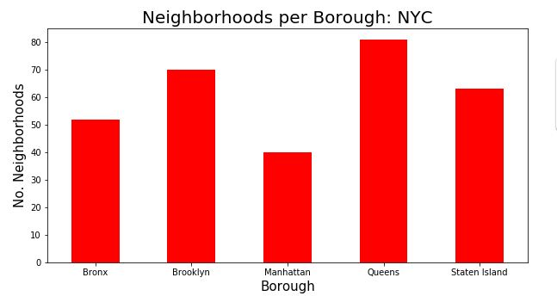
Result

Slide 7
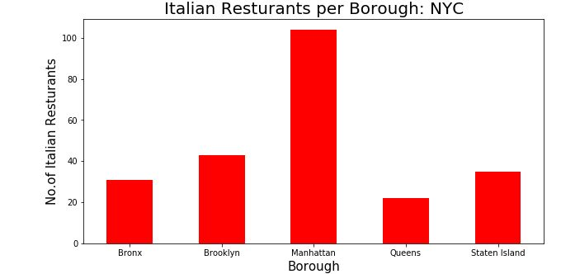

Slide 8
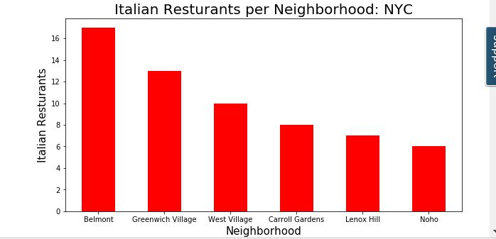

Slide 9
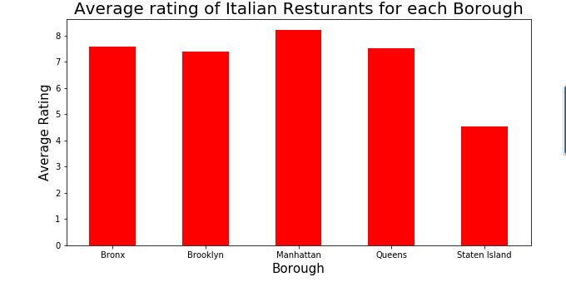

Slide 10
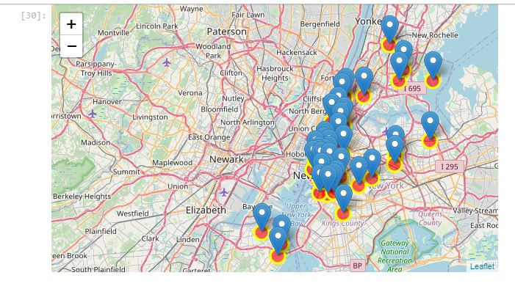
Map of the neighbourhoods with an average rating greater than or equal to 8

Slide 11
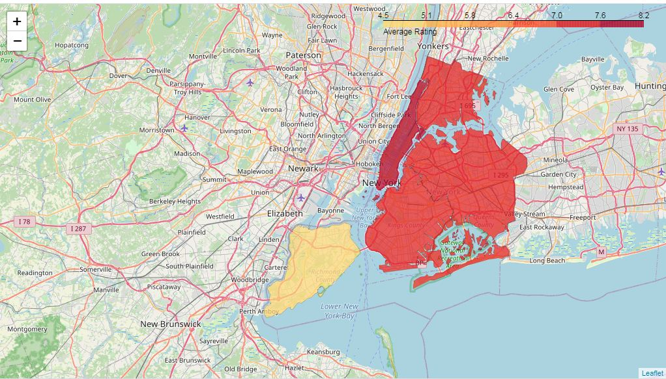
Finally, visualize all NYC boroughs based on average Rating

Slide 12
.
Based on this information, I would state that Manhattan and Queens are the best locations for Italian cuisine in NYC.
To have the best shot of success, I would open an Italian restaurants in Queens. Queens has multiple neighbourhoods with average ratings exceeding 8.0 of a scale of 1.0 to 10.0 and has the least number of Italian restaurants making competition easier than in other boroughs.
Finally, I would go to Gramercy in Manhattan for the best Italian food based on 1453 likes.

Slide 13
Conclusion
As a final note, all of the above analysis is depended on the adequacy and accuracy of Four Square data. A more comprehensive analysis and future work would need to incorporate data from other external databases.

